Slide 1


London bike sharing

Slide 2

CONTENTS:
Introduction
data description
EDA
Question/need
Conculsion

Slide 3
Introduction:
The London Public Bike Scheme is a great way to get around the city, and getting started is very easy: just rent a bike, ride it wherever you want, and return it to any of the docking stations around the city.
bike-sharing company
The London Cycling Infrastructure Database (CID) is the world's largest and most comprehensive database of cycling infrastructure, containing extensive infrastructure details and weather news in the capital.

Slide 4
Introduction:
MOTIVATIONS:
The aim of this project is to try to understand the effect of weather, seasons,
and times of days (vacation) on the number of bike shares to help understand which factors are most important in increasing bike use, and how these factors relate to controlling increased bike rents.

Slide 5
DESCRIBE DATA:
I have 10 columns and more than 17,000 rows.
No duplications were found in the dataset
No missing values.
a lot of outliers were observed.

Slide 6
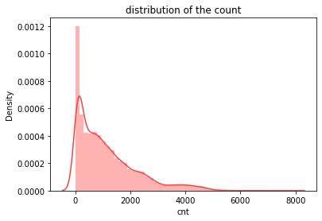
EDA:
DISTRIBUTION OF THE COUNT

Slide 7
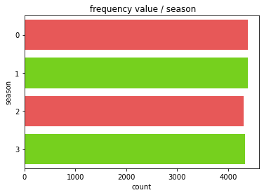
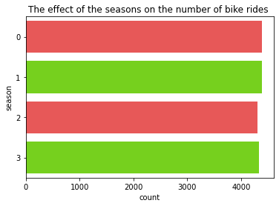
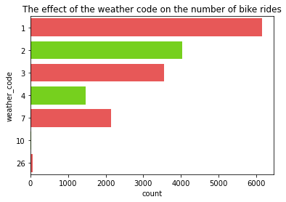
EDA:
THE EFFECT OF THE SEASONS AND THE WEATHER CODE ON THE NUMBER OF BIKE RIDES

Slide 8
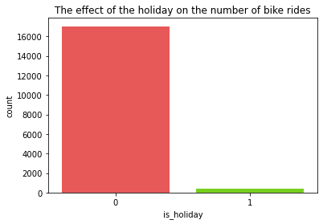
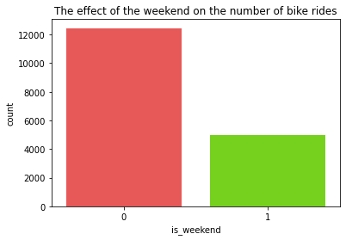
EDA:
THE EFFECT OF THE HOLIDAY AND WEEKEND ON THE NUMBER OF BIKE RIDES

Slide 9
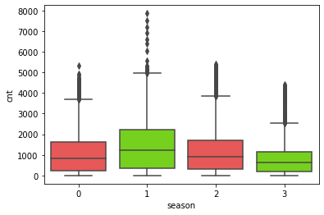
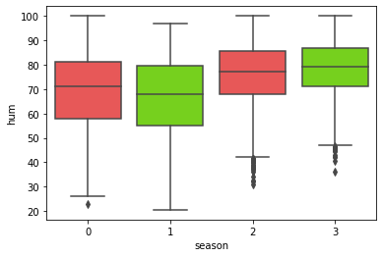
EDA:
OUTLIERS CHECK

Slide 10
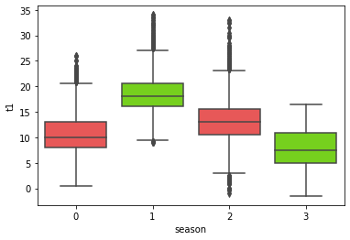
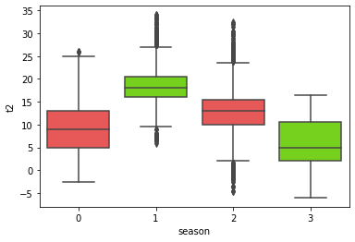
EDA:
OUTLIERS CHECK

Slide 11
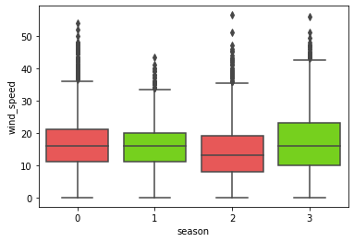
EDA:
OUTLIERS CHECK

Slide 12
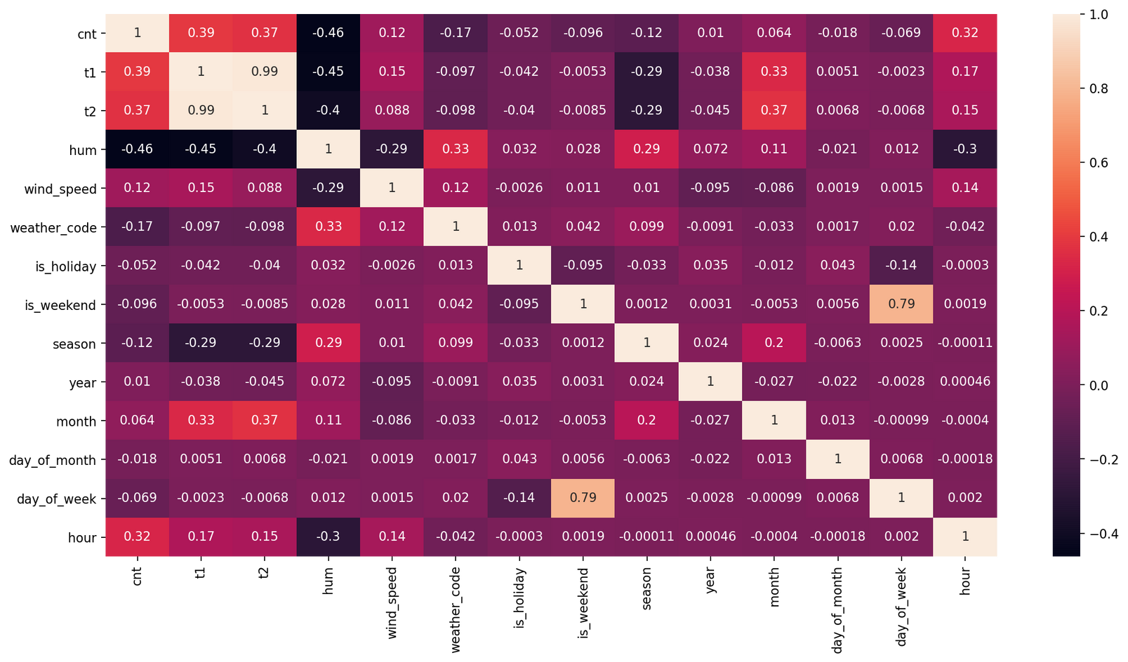
EDA:
SHOW ALL CORRELATION BETWAN EACH COLUMNS

Slide 13
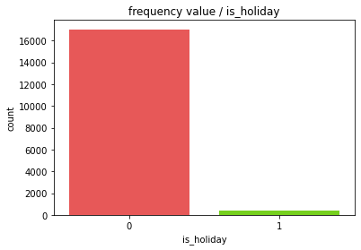
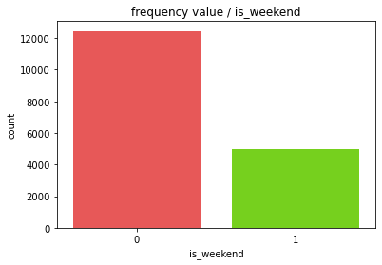
Question:
Was the use of grades during the holidays more or not? yes
Was the use of grades during the weekend more or not? yes

Slide 14
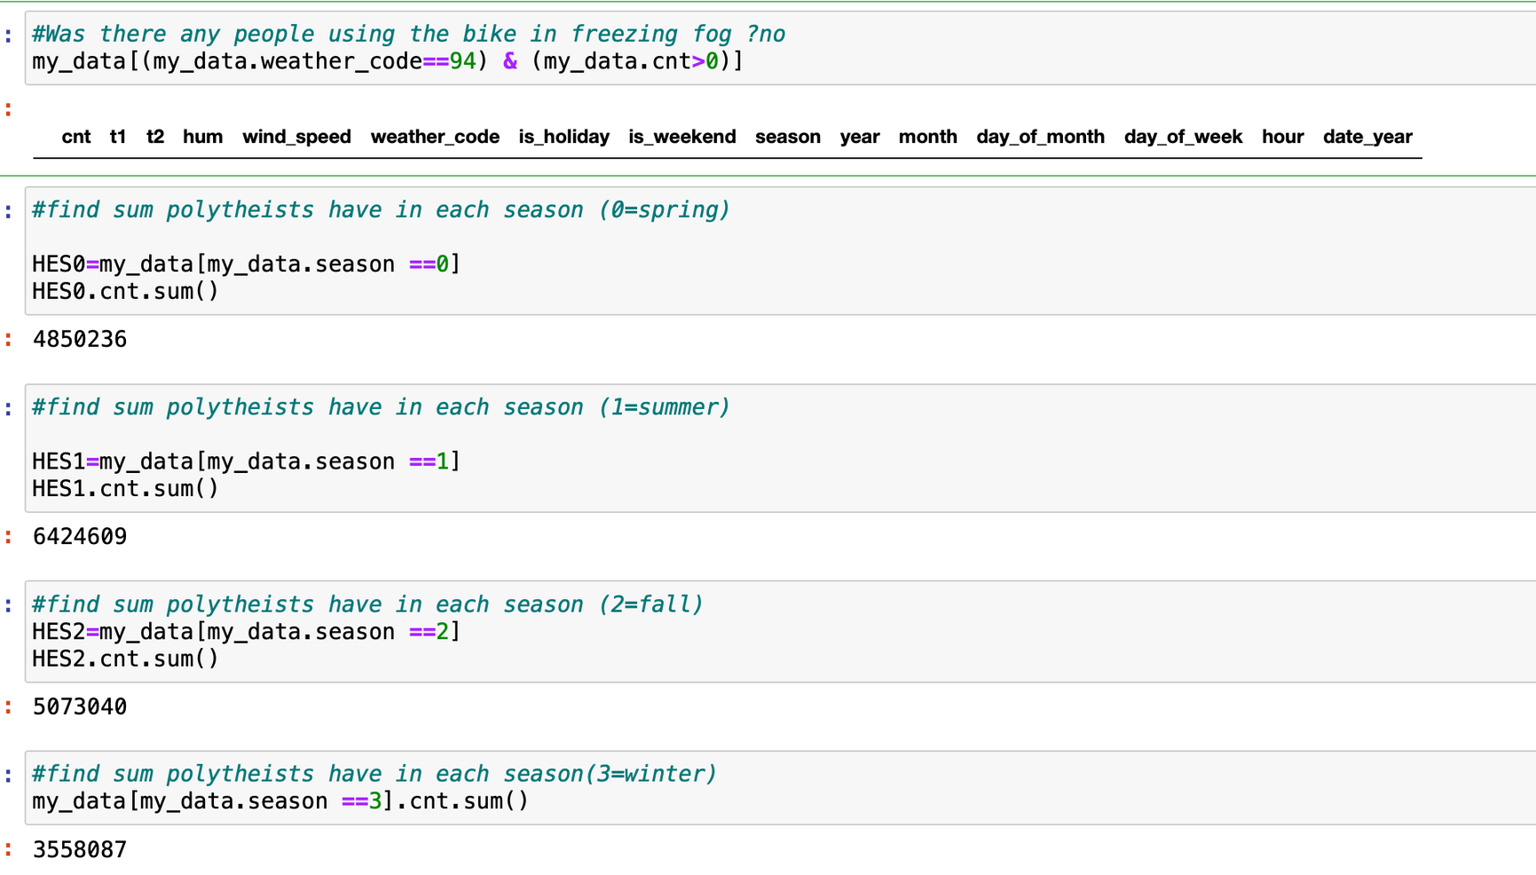
Question:

Slide 15
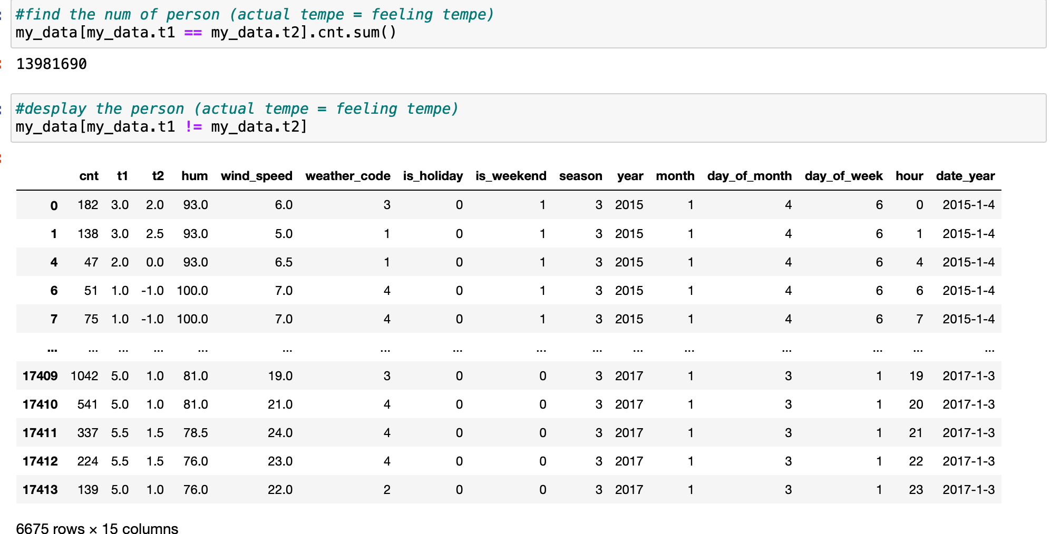
Question:

Slide 16
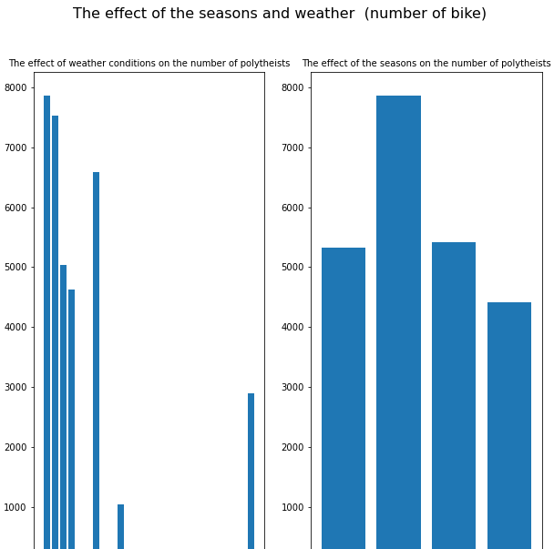
Conculsion:
There is a strong influence of seasons and weather on the number of subscribersAs the summer season had more subscribers, while the winter season was the opposite and the effect of air purity has a very big effect.

Slide 17
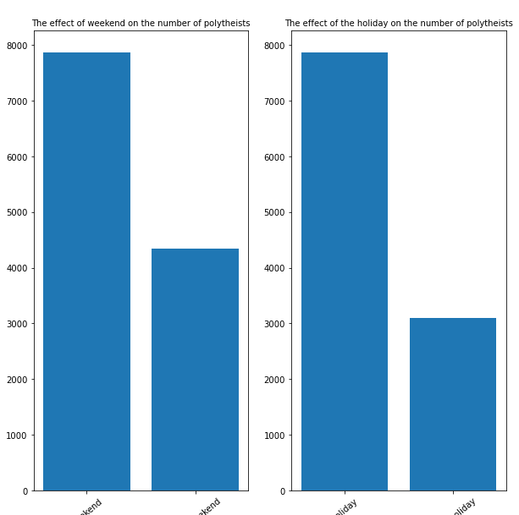
Conculsion:
There is a strong effect between the vacation on the number of subscribers as vacation time increases the number of subscribers.

Slide 18
Thanks
question?

